Slide 1
Git Cherry Pick
Cherry picking is the act of picking a commit from a branch and applying it to another.
git cherry-pick can be useful for undoing changes. For example, say a commit is accidently made to the wrong branch. You can switch to the correct branch and cherry-pick the commit to where it should belong.
Benefits:
Team Collaboration:There may be some shared code between to two product sectors. Maybe the backend developer creates a data structure that the frontend will also need to utilize. The frontend developer could use git cherry-pick to pick the commit in which this hypothetical data structure was created. This pick would enable the frontend developer to continue progress on their side of the project.
Bug Hotfixes:For an example scenario,say a developer has started work on a new feature. During that new feature development they identify a pre-existing bug. The developer creates an explicit commit patching this bug. This new patch commit can be cherry-picked directly to the main branch to fix the bug before it effects more users.
Undoing Changes:Sometimes a feature branch may go stale and not get merged into main. Sometimes a pull request might get closed without merging. Git never loses those commits and through commands like git log and git reflog they can be found and cherry picked back to life.

Slide 2
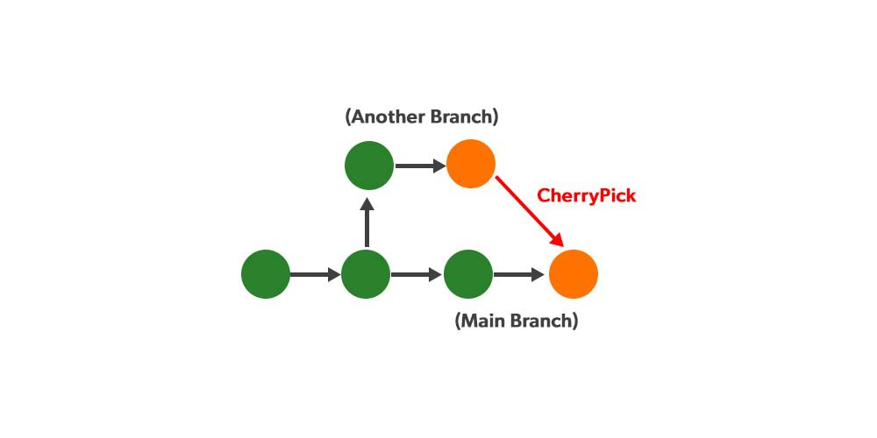

Slide 3
How to use cherry-pick
To demonstrate how to use git cherry-pick let us assume we have a repository with the following branch state:
a— b—c—d Main
e—f—g Feature
git cherry-pick usage is straightforward and can be executed like:
git cherry-pick commitSha
In this example commitSha is a commit reference. In this example we have constructed lets say we wanted to use commit `f` in main. First we ensure that we are working on the main branch.
git checkout main
Then we execute the cherry-pick with the following command:
git cherry-pick f
Git history looks like: a— b—c—d —f Main
e—f—g Feature

Slide 4
Git Reflog
The reflog is Git’s safety net. It records almost every change you make in your repository, regardless of whether you committed a snapshot or not. You can think of it as a chronological history of everything you’ve done in your local repo. To view the reflog, run the git reflog command. It should output something that looks like the following:
400e4b7 HEAD@{0}: checkout: moving from main to HEAD~2 0e25143 HEAD@{1}: commit (amend): Integrate some awesome feature into `main` 00f5425 HEAD@{2}: commit (merge): Merge branch ';feature'; ad8621a HEAD@{3}: commit: Finish the feature
This can be translated as follows
You just checked out HEAD~2
Before that you amended a commit message
Before that you merged the feature branch into main
Before that you committed a snapshot

Slide 5
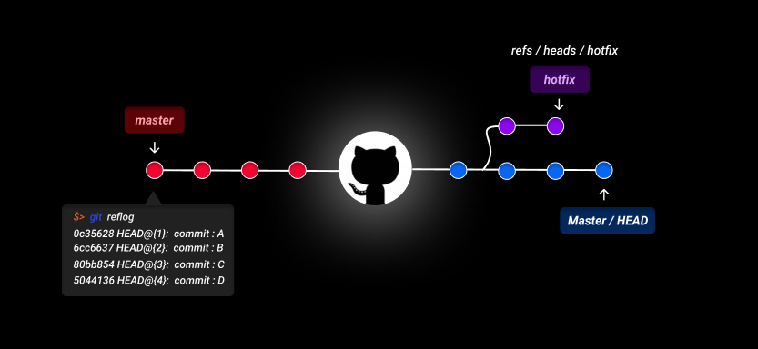

Slide 6
The HEAD{} syntax lets you reference commits stored in the reflog.
You can use this to revert to a state that would otherwise be lost. For example, lets say you just scrapped a new feature with git reset. Your reflog might look something like this:
ad8621a HEAD@{0}: reset: moving to HEAD~3 298eb9f HEAD@{1}: commit: Some other commit message bbe9012 HEAD@{2}: commit: Continue the feature 9cb79fa HEAD@{3}: commit: Start a new feature
The three commits before the git reset are now dangling, which means that there is no way to reference them—except through the reflog. Now, let’s say you realize that you shouldn’t have thrown away all of your work. All you have to do is check out the HEAD@{1} commit to get back to the state of your repository before you ran git reset.
git checkout HEAD@{1}
This puts you in a detached HEAD state. From here, you can create a new branch and continue working on your feature.

Slide 7
Git Rebase
As an alternative to merging, you can rebase the feature branch onto main branch using the following commands:
git checkout feature
git rebase main
This moves the entire feature branch to begin on the tip of the main branch, effectively incorporating all of the new commits in main. But, instead of using a merge commit, rebasing re-writes the project history by creating brand new commits for each commit in the original branch.

Slide 8
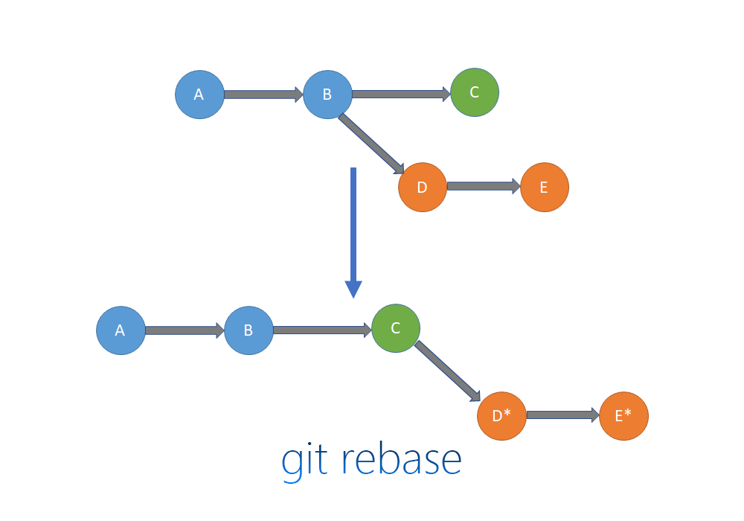

Slide 9
Benefits
The major benefit of rebasing is that you get a much cleaner project history. First, it eliminates the unnecessary merge commits required by git merge. Second, as you can see in the above diagram, rebasing also results in a perfectly linear project history—you can follow the tip of feature all the way to the beginning of the project without any forks. This makes it easier to navigate your project with commands like git log, git bisect, and gitk.

Slide 10
Git Stash
Git stash enables you to save your code without making a commit.
When you run git stash, the uncommitted code disappears without being committed. Stashing is like saving a temporary local commit to your branch. It is not possible to push a stash to a remote repository, so a stash is just for your own personal use.
Your branch now appears as it was when you made your last commit. Now, you can safely change branches without losing your code or having a messy commit. When you switch back to your branch and run git stash list you’ll see a list of stashes .

Slide 11
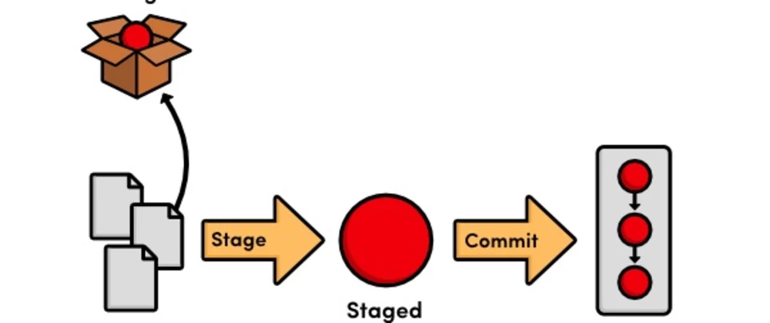
$ git status
On branch my-feature
Changes not staged for commit:
(use "git add <file>..." to update what will be committed)
(use "git checkout -- <file>..." to discard changes in working directory)
modified: css/common.scss
no changes added to commit (use "git add" and/or "git commit -a")
$ git diff
diff --git a/css/common.scss b/css/common.scss
index 2090cc4..90fd457 100644
--- a/css/common.scss
+++ b/css/common.scss
@@ -13,6 +13,6 @@
body {
font-family: "Proxima Nova", Arial, sans-serif;
font-size: 13px;
- color: #333;
+ color: red;
background-color: #f00;
}

Slide 12
Git Bisect
git bisect essentially performs a binary search between two given commits and then presents you with a specific commit’s details. You first need to give Git a good commit, where you know your functionality was working, and a bad commit. Note that as long as you have one good commit and one bad, the commits can be years apart.
If I open my webpage on the most recent commit hash, the text is red, so I know I have a problem.
The text is no longer red, so this is a good commit! The newer commit the commit- i.e., the closer to the bad commit, the better:
Git will now tell you how many commits it has to search before finding the right one. The number of commits Git will traverse depends on how many commits are in between the good and bad commit (the longer length of time, the more times Git needs to iterate).

Slide 13
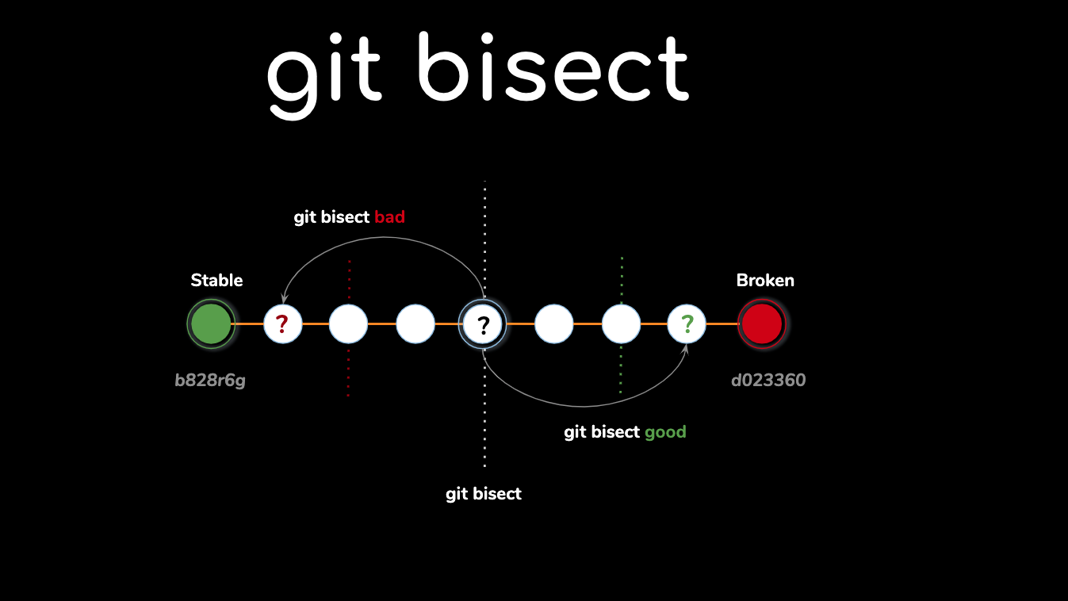

Slide 14
Git Switch
git switch [<options>] [--no-guess] <branch>
git switch [<options>] --detach [<start-point>]
git switch [<options>] (-c|-C) <new-branch> [<start-point>]
git switch [<options>] --orphan <new-branch>
Switch to a specified branch. The working tree and the index are updated to match the branch. All new commits will be added to the tip of this branch.

Slide 15
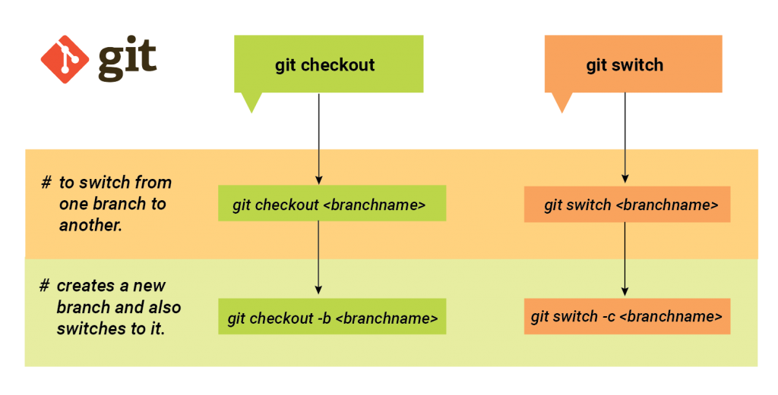

Slide 16
Git Diff
git diff [<options>] [<commit>] [--] [<path>…​]
git diff [<options>] --cached [--merge-base] [<commit>] [--] [<path>…​]
git diff [<options>] [--merge-base] <commit> [<commit>…​] <commit> [--] [<path>…​]
git diff [<options>] <commit>…​<commit> [--] [<path>…​]
git diff [<options>] <blob> <blob>
git diff [<options>] --no-index [--] <path> <path>
Show changes between the working tree and the index or a tree, changes between the index and a tree, changes between two trees, changes resulting from a merge, changes between two blob objects, or changes between two files on disk.

Slide 17
git diff [<options>] [--] [<path>…​]
This form is to view the changes you made relative to the index (staging area for the next commit). In other words, the differences are what you could tell Git to further add to the index but you still haven’t. You can stage these changes by using git-add[1].
git diff [<options>] --no-index [--] <path> <path>
This form is to compare the given two paths on the filesystem.
git diff [<options>] --cached [--merge-base] [<commit>] [--] [<path>…​]
This form is to view the changes you staged for the next commit relative to the named <commit>. Typically you would want comparison with the latest commit, so if you do not give <commit>, it defaults to HEAD. If HEAD does not exist (e.g. unborn branches) and <commit> is not given, it shows all staged changes. --staged is a synonym of --cached.
If --merge-base is given, instead of using <commit>, use the merge base of <commit> and HEAD. git diff --cached --merge-base A is equivalent to git diff --cached $(git merge-base A HEAD).
git diff [<options>] [--merge-base] <commit> [--] [<path>…​]
This form is to view the changes you have in your working tree relative to the named <commit>. You can use HEAD to compare it with the latest commit, or a branch name to compare with the tip of a different branch.
If --merge-base is given, instead of using <commit>, use the merge base of <commit> and HEAD. git diff --merge-base A is equivalent to git diff $(git merge-base A HEAD).

Slide 18
git diff [<options>] [--merge-base] <commit> <commit> [--] [<path>…​]
This is to view the changes between two arbitrary <commit>.
If --merge-base is given, use the merge base of the two commits for the "before" side. git diff --merge-base A B is equivalent to git diff $(git merge-base A B) B.
git diff [<options>] <commit> <commit>…​ <commit> [--] [<path>…​]
This form is to view the results of a merge commit. The first listed <commit> must be the merge itself; the remaining two or more commits should be its parents. A convenient way to produce the desired set of revisions is to use the ^@ suffix. For instance, if master names a merge commit, git diff master master^@ gives the same combined diff as git show master.
git diff [<options>] <commit>..<commit> [--] [<path>…​]
This is synonymous to the earlier form (without the ..) for viewing the changes between two arbitrary <commit>. If <commit> on one side is omitted, it will have the same effect as using HEAD instead.
git diff [<options>] <commit>...<commit> [--] [<path>…​]
This form is to view the changes on the branch containing and up to the second <commit>, starting at a common ancestor of both <commit>. git diff A...B is equivalent to git diff $(git merge-base A B) B. You can omit any one of <commit>, which has the same effect as using HEAD instead.

